Slide 1

Learn Mandarin with Spotify…? 用Spotify学习普通话…? Machine Learning Project
STUART LEE GENERAL ASSEMBLY
Notes:
I investigated whether its possible to make music more accessible to people learning a foreign language, specifically looking at Mandarin as an example

Slide 2
Questions:
Can machine learning be utilized to identify songs which are easier to understand for language learners?
Can it be used to classify songs based on their difficulty?
Can it create customized playlists?

Slide 3
Process Summary:
Crawler to find songs
Lyric Scraping
Difficulty Grading
Data Cleaning
Graphics
Modelling

Slide 4


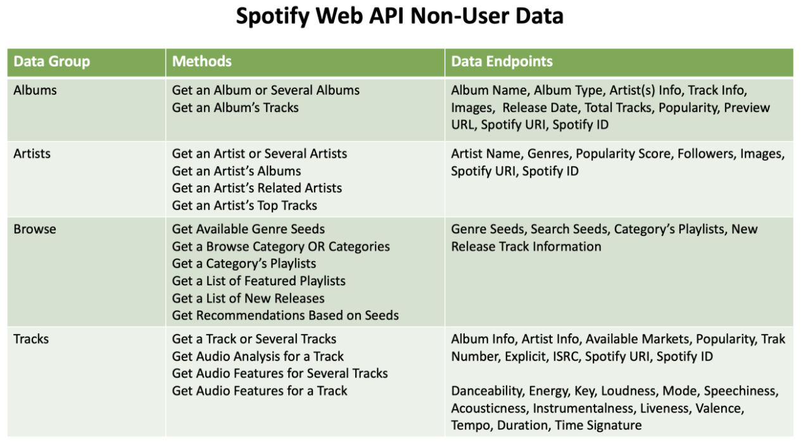

Crawler to find songs

Slide 5

Find Similar Artists
(2000)
Find Albums
Find Songs
(65,000+)
Crawler to find songs
Artist 4
Artist 2
Artist 5
Artist 1
Artist 6
Artist 3
Artist 7

Slide 6


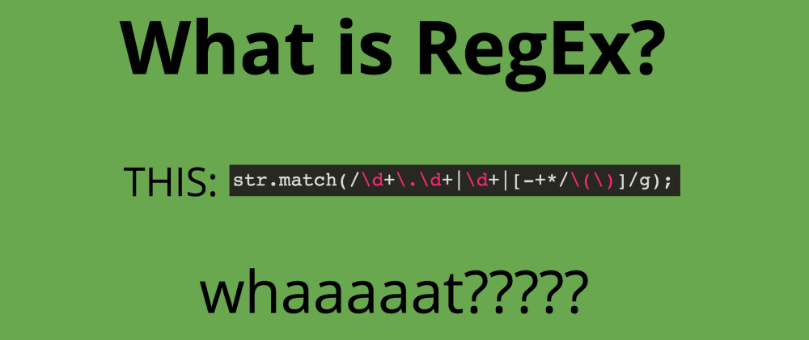
Find Songs
(65,000)
Scrape Lyrics
(55,000)
Lyric Scraping

Slide 7

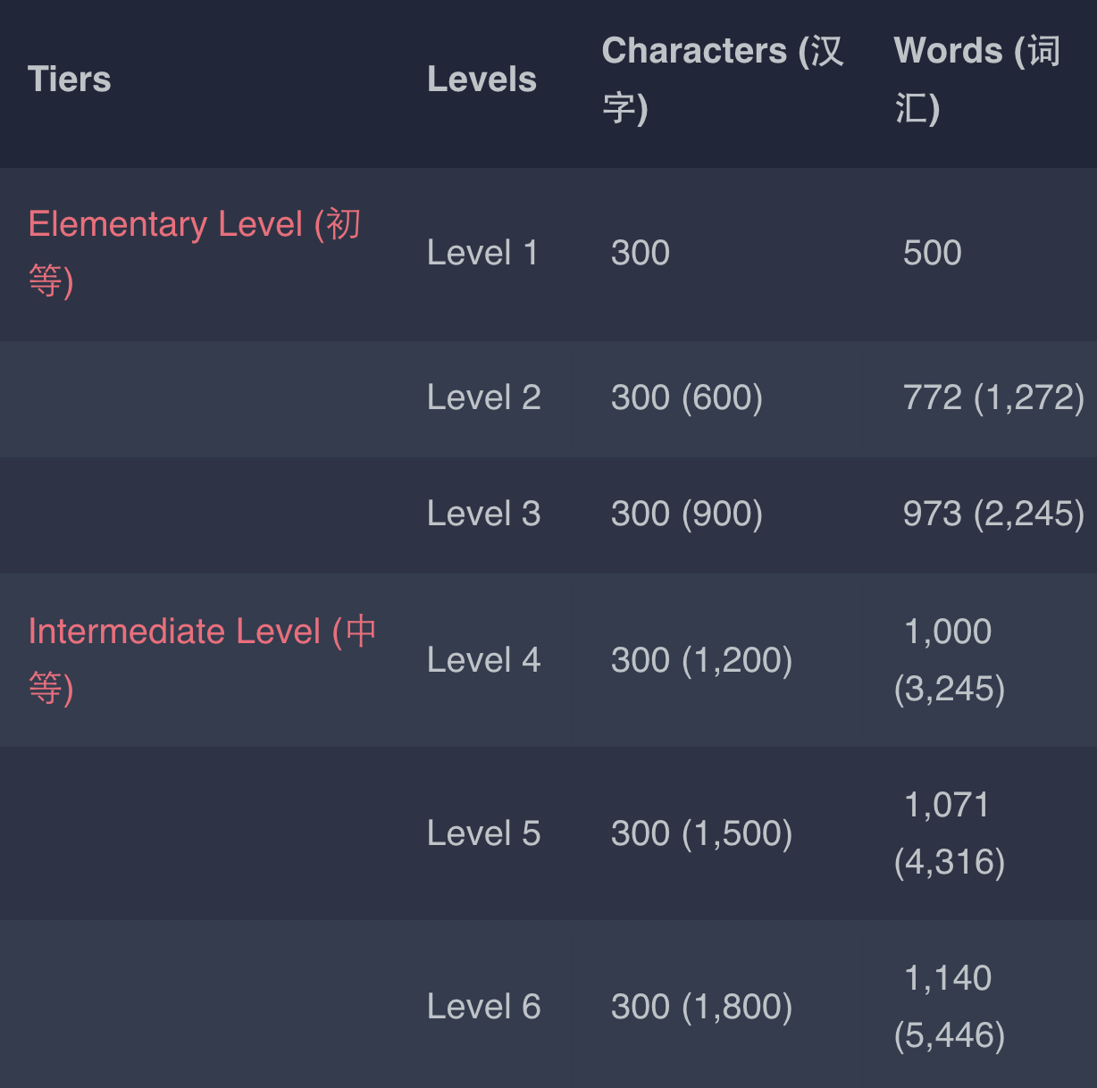
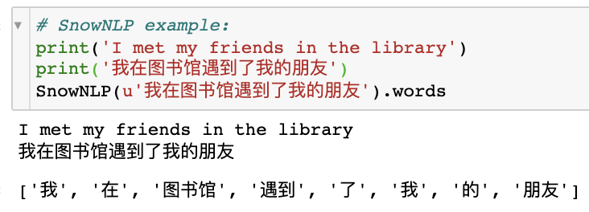
Difficulty Grading

Slide 8
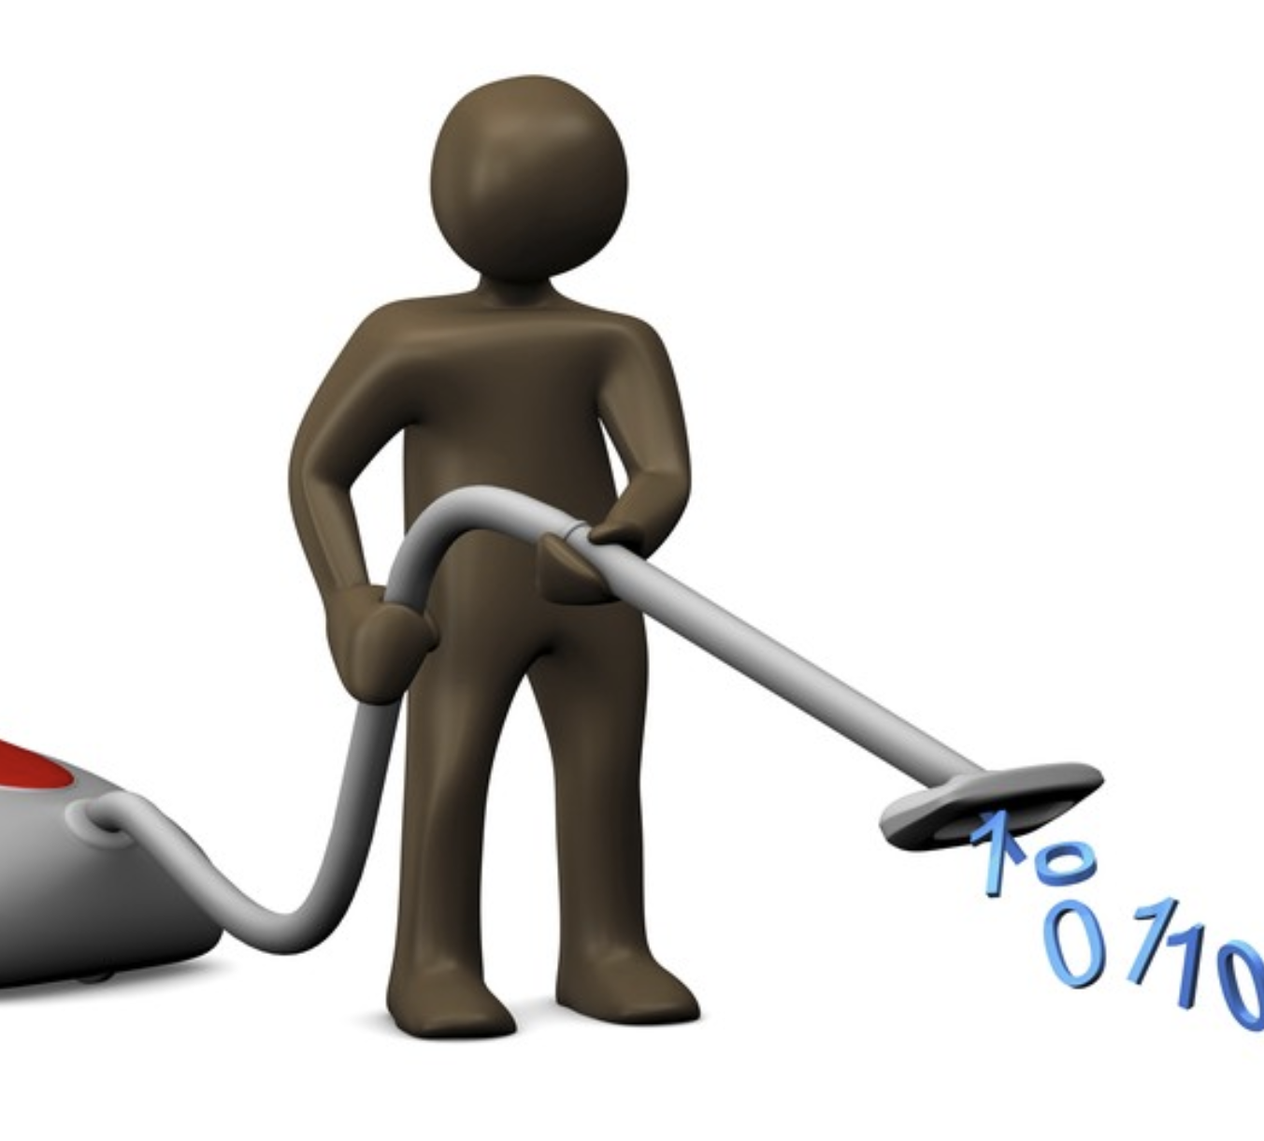
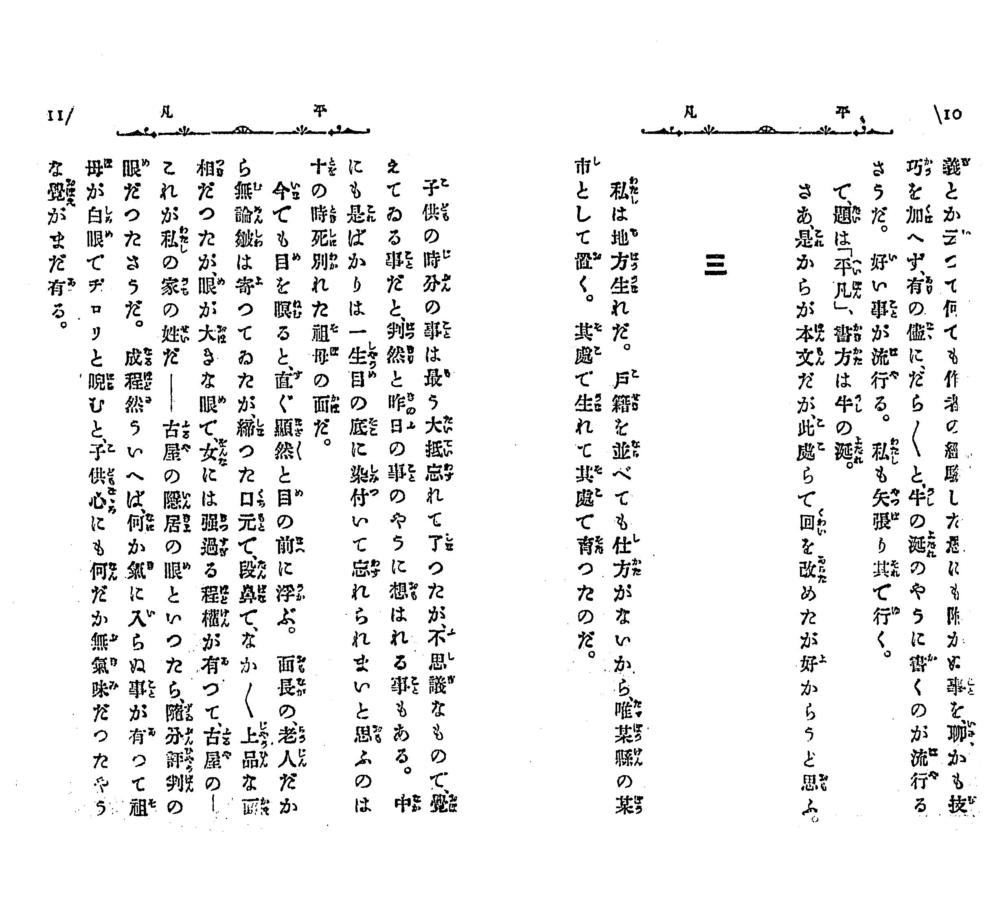
Data Cleaning
Y (Target) | Predictor Variables
HSK Levels | Spotify Meta Data | Lyrics
1-6 | (e.g. artist, tempo, )

Slide 9

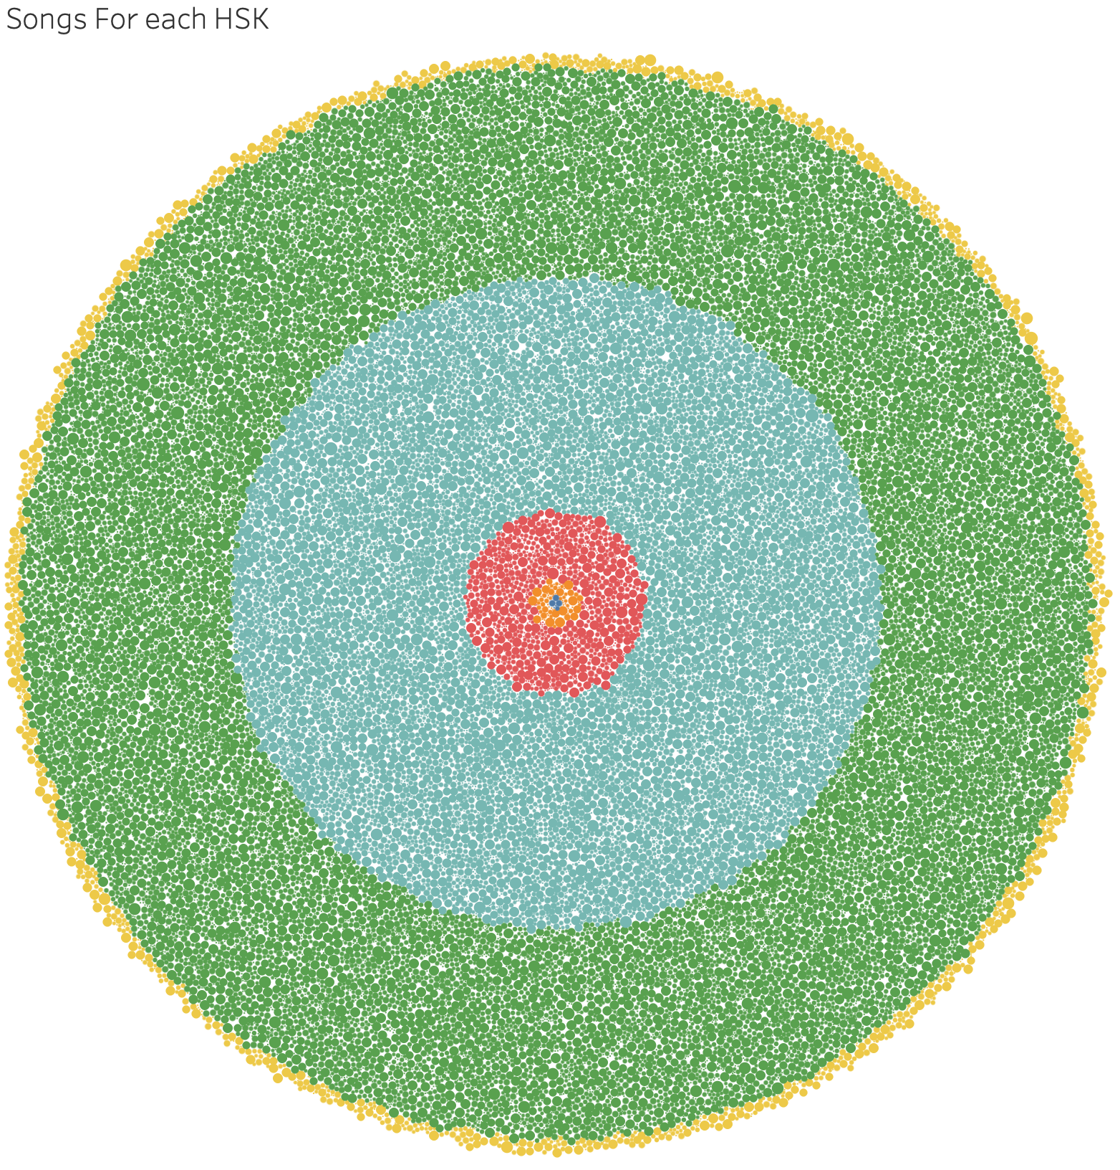
Graphics

Slide 10
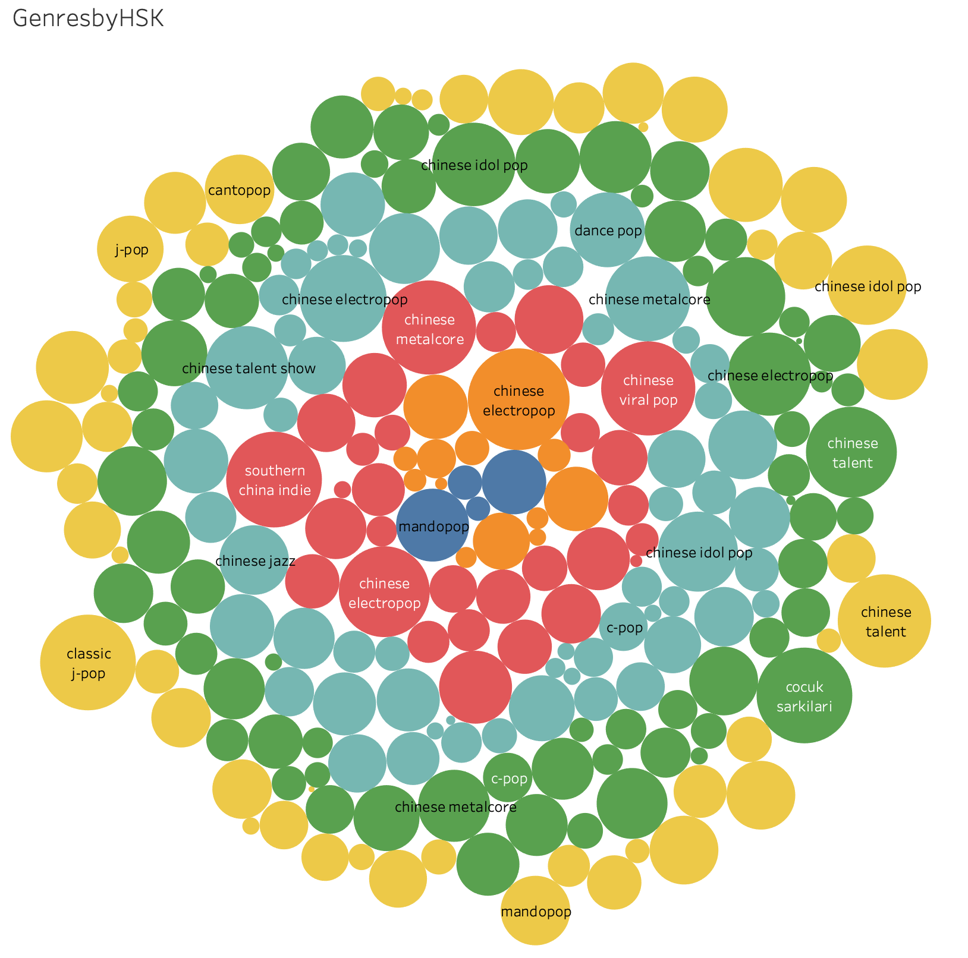
Graphics

Slide 11
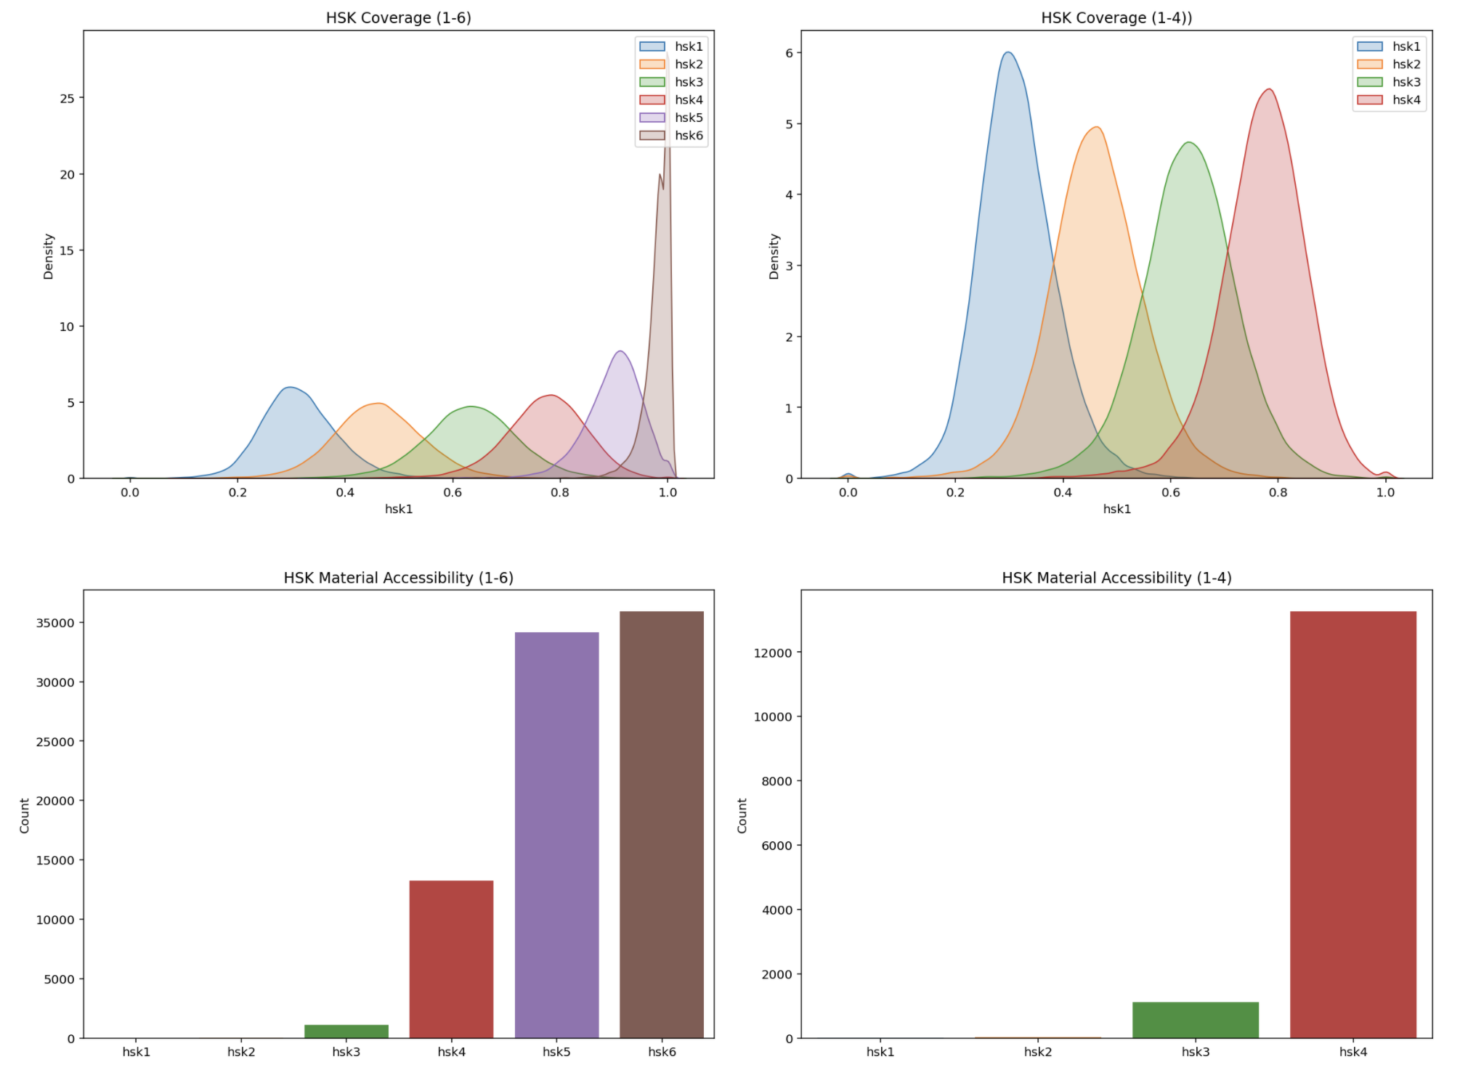
Graphics

Slide 12
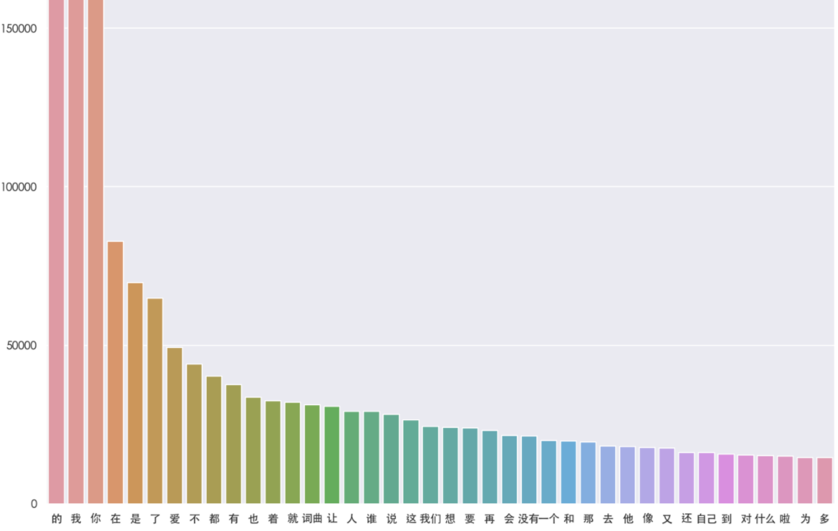
Graphics

Slide 13
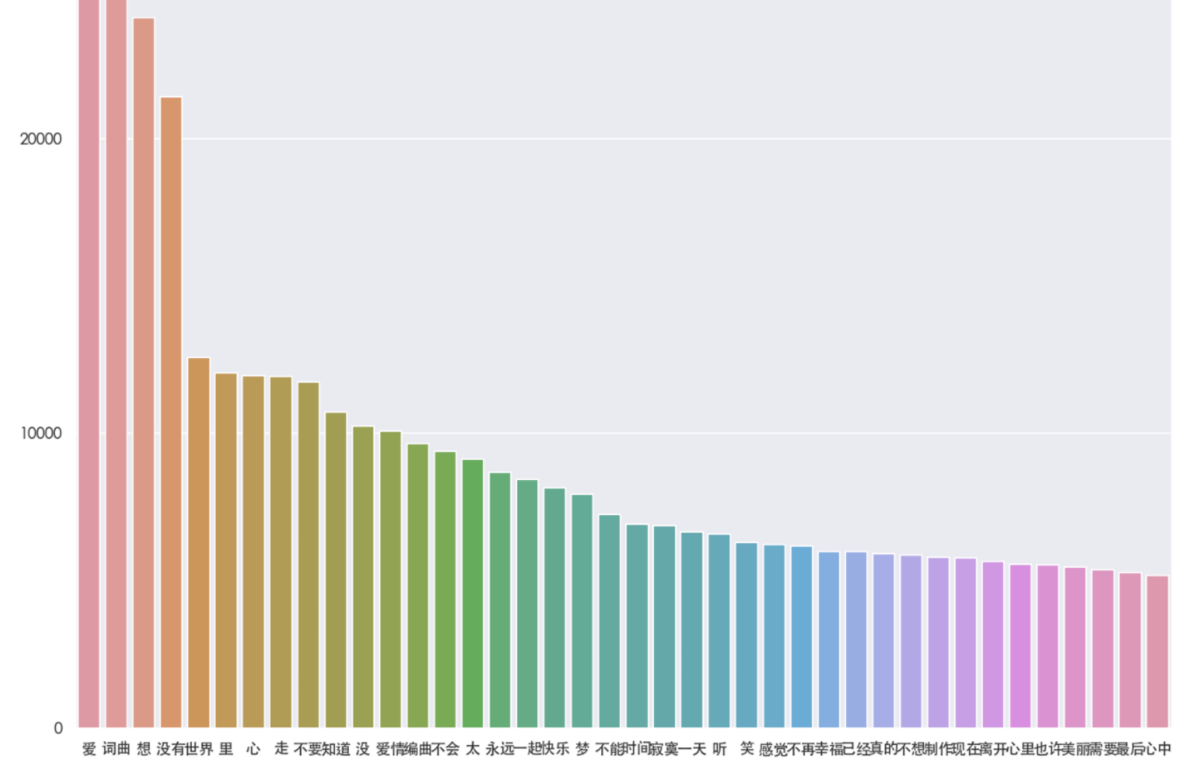
Graphics

Slide 14

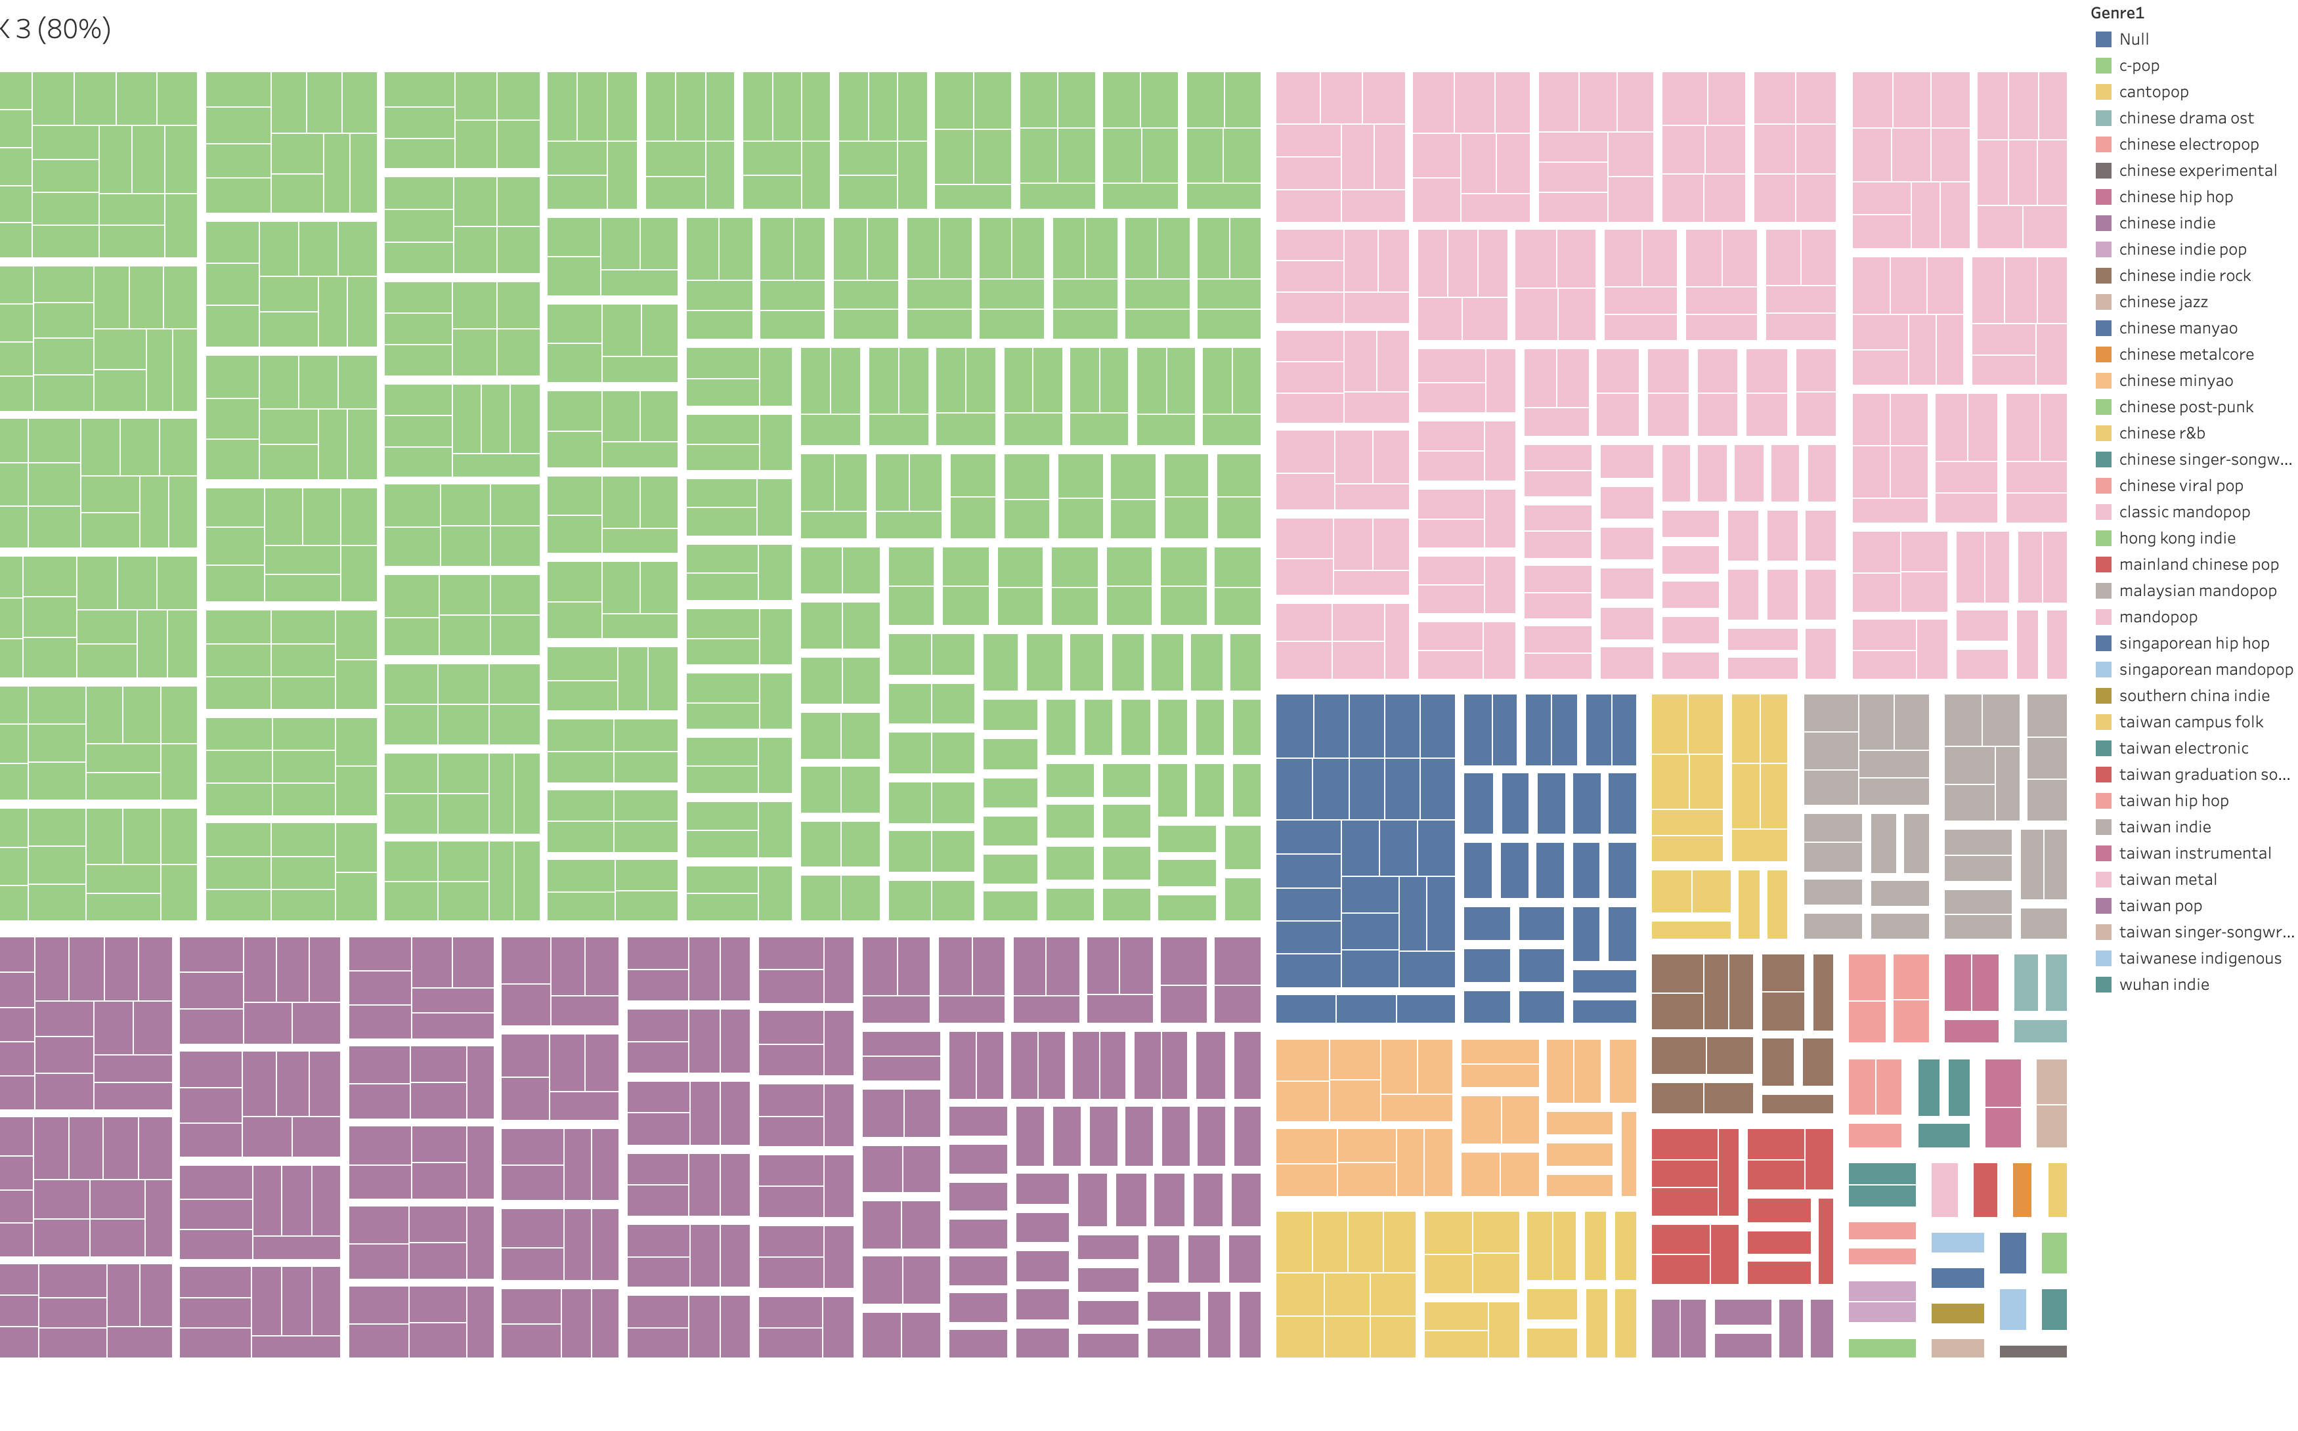
Graphics
https://prod-uk-a.online.tableau.com/#/site/spottylinguist/views/SpottyLinguist/Home?:iid=3

Slide 15
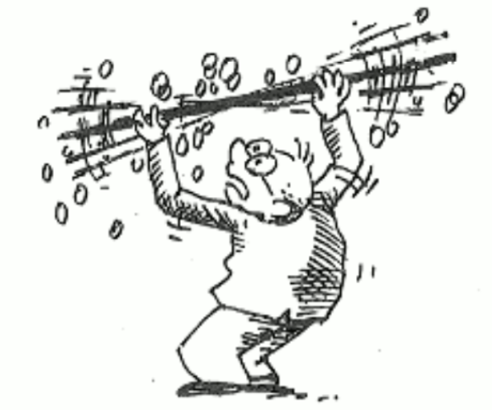
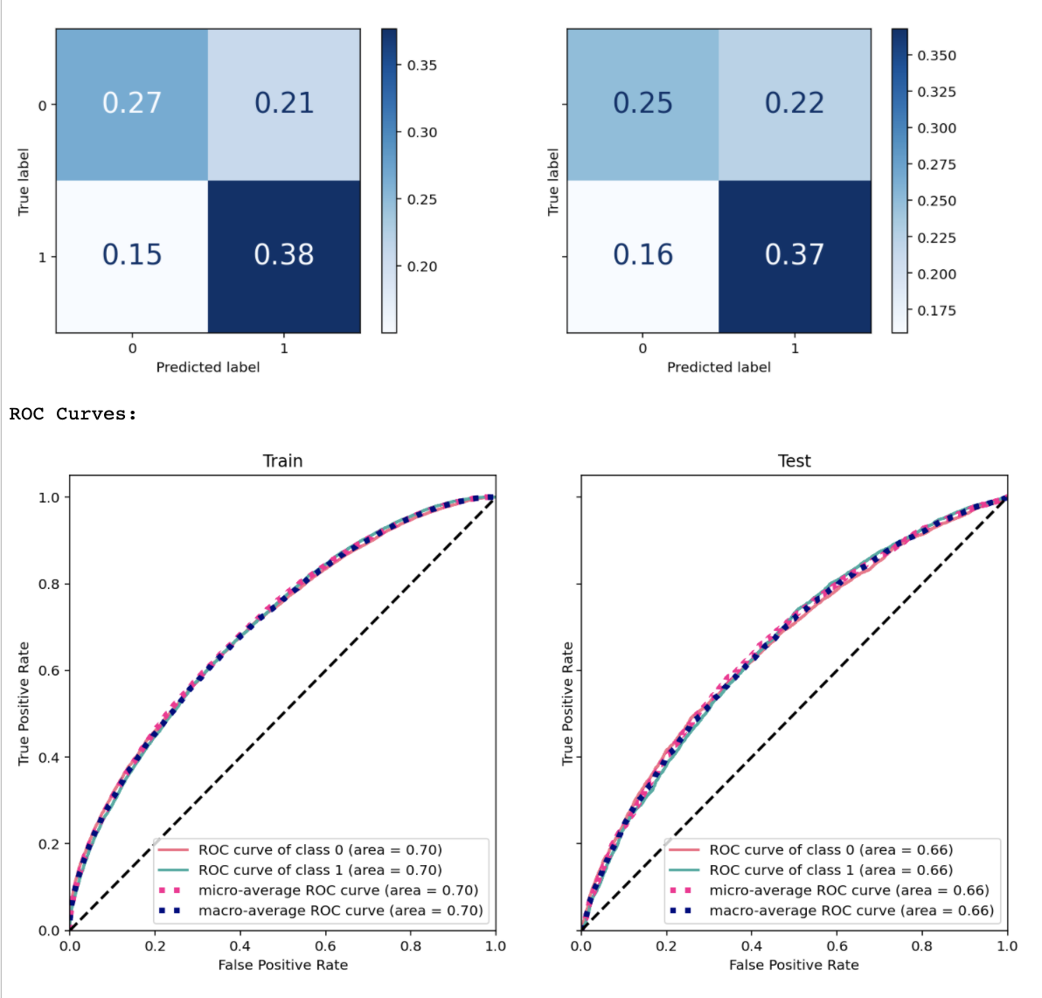
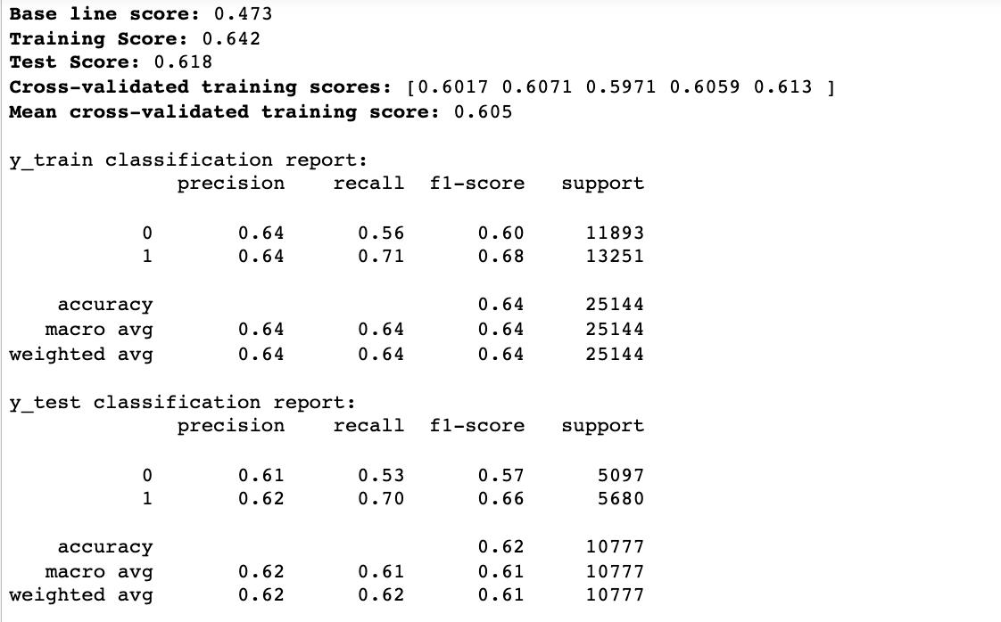
Modelling 1: Binary Classification of Language Difficulty Using Spotify Song Data
Notes:
Chinese R&B.
CVEC v. TFID

Slide 16
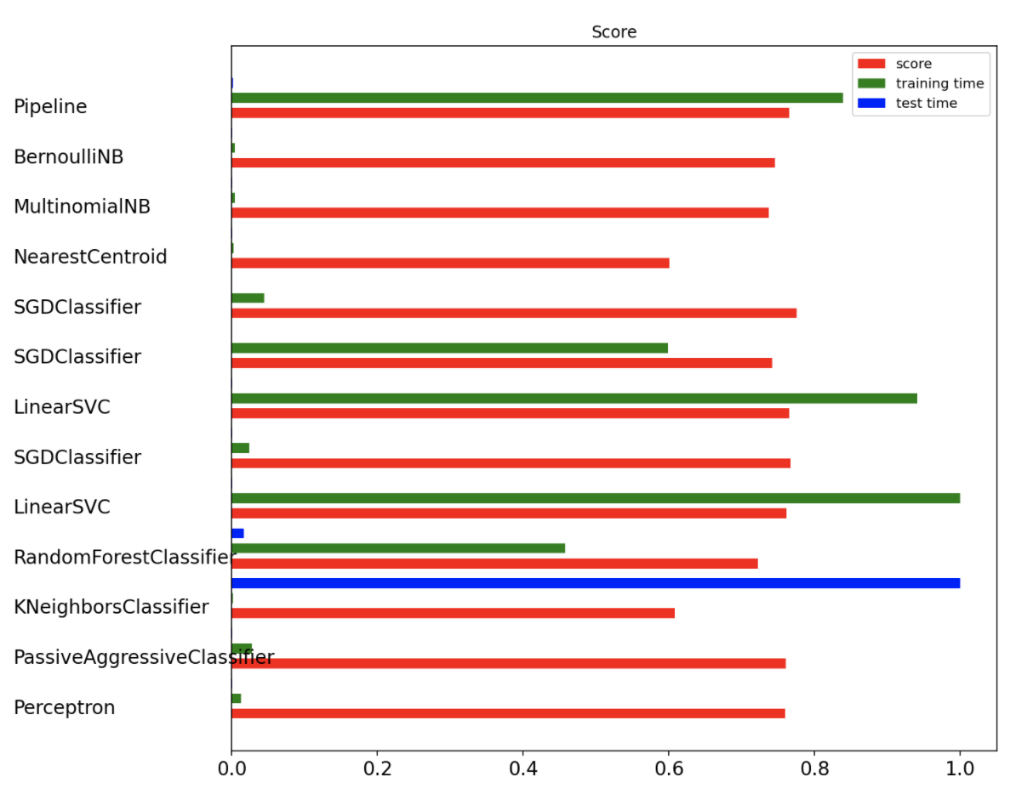
Modelling 2: Binary Classification of Language Difficulty Using Lyrics

Slide 17
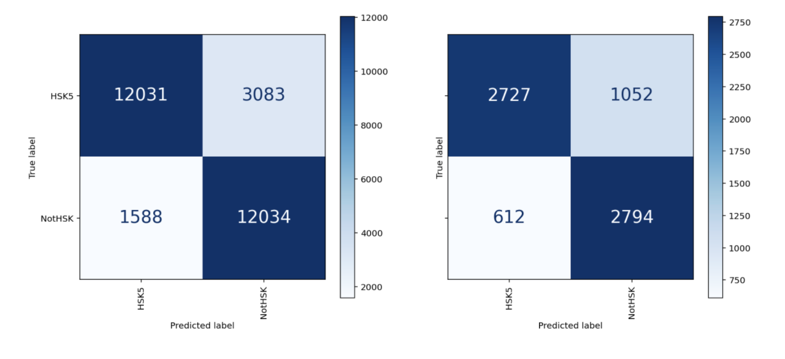
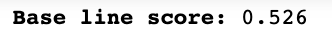
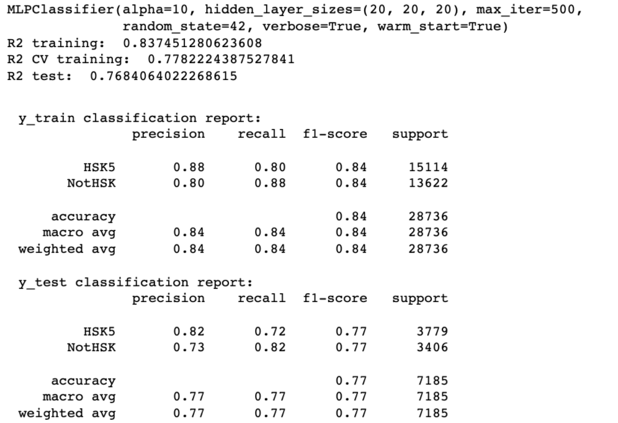
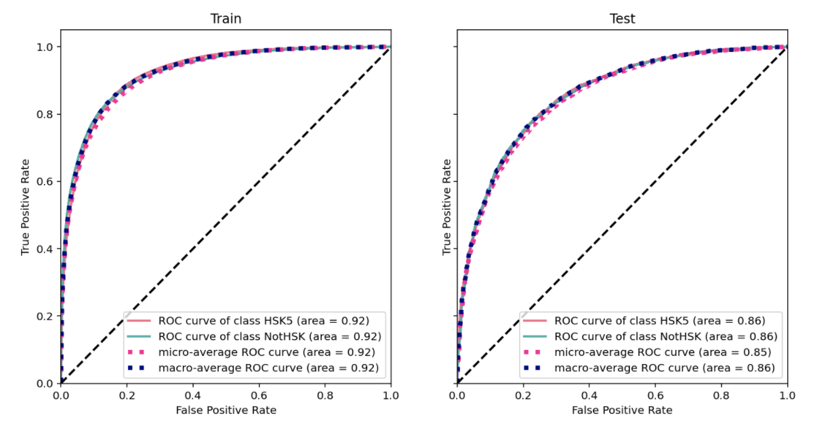
Winner… Multilayer Perceptron Feed-Forward network - activation: 'relu', Grid Search SnowNLP

Slide 18
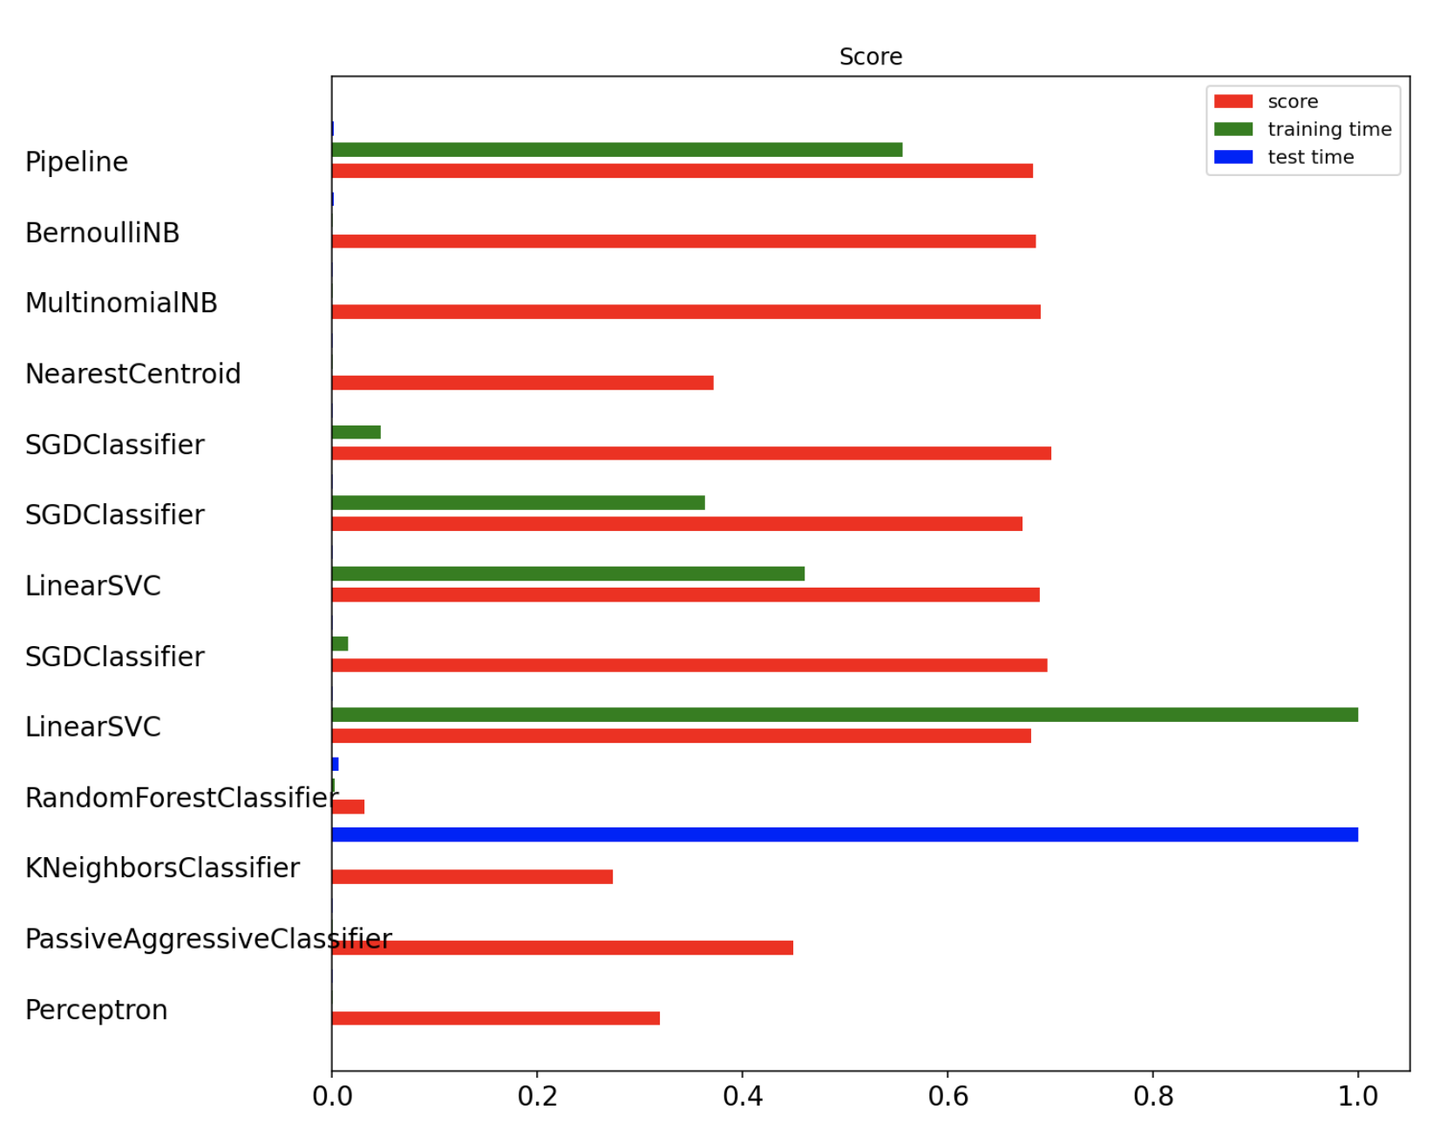
Modelling 3: Multi Classification of Language Difficulty Using Lyrics

Slide 19
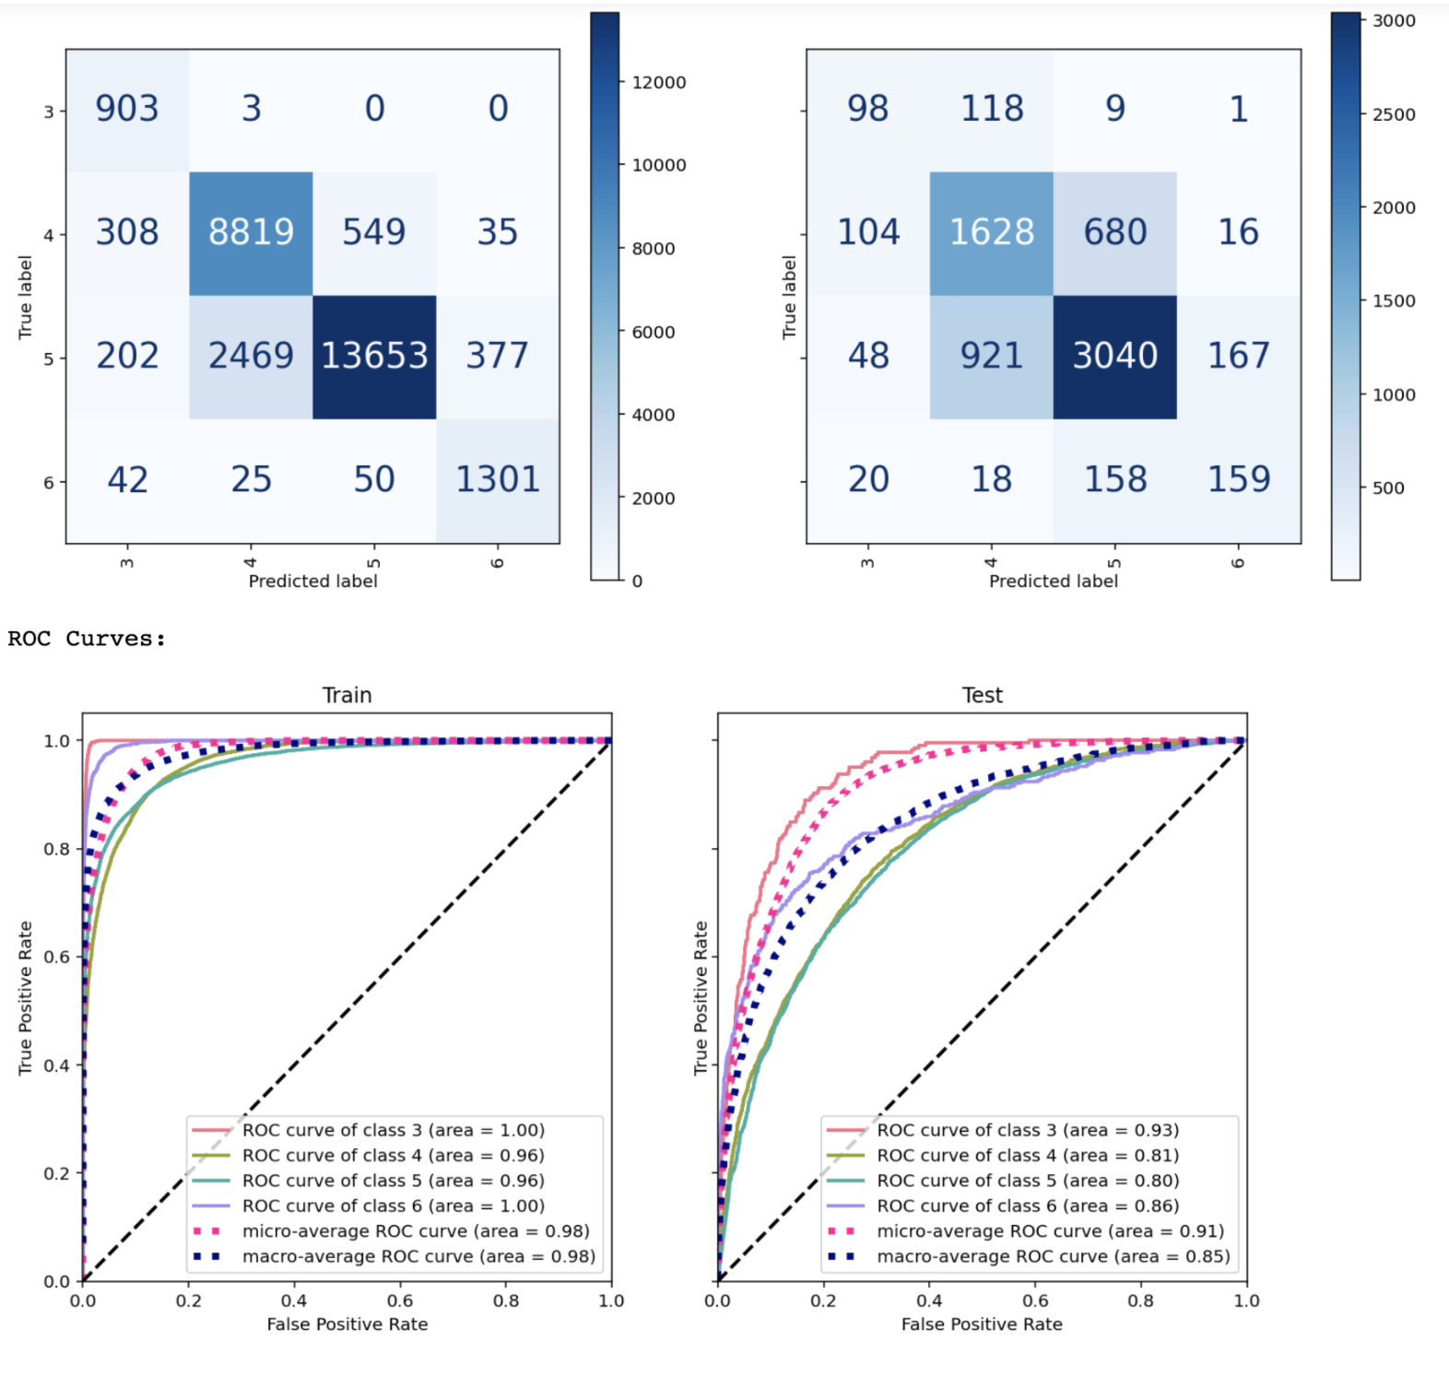
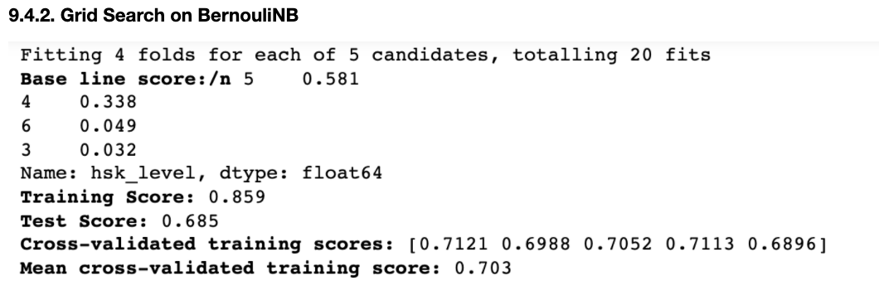
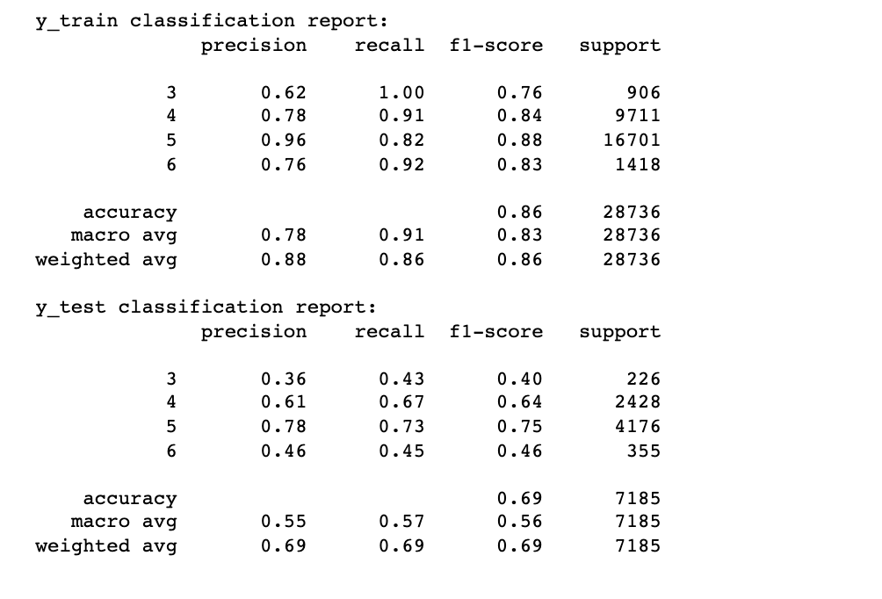
Winner… MultinomialNB
Notes:
weights

Slide 20
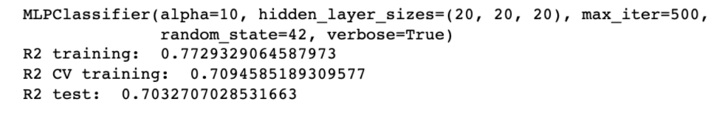
2nd Place… Multilayer Perceptron Feed-Forward network - activation: 'relu', Grid Search

Slide 21




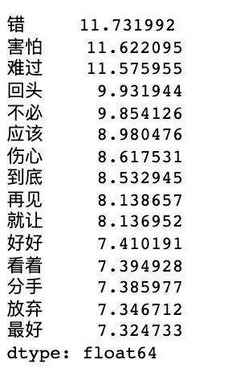
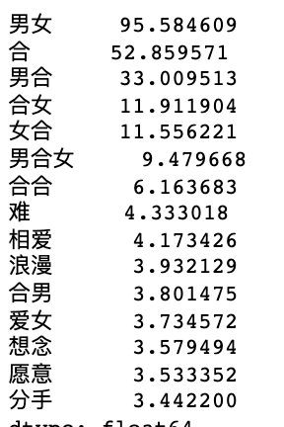
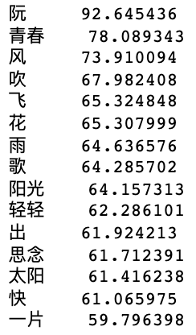
?
Modelling 3: Unsupervised Classification Models to Identify Topics?
?
?
?
?
?
Boyfriend
Combine
Girl friend
Boyfriend & girlfriend
Hehe
Difficult
Love each other
Romantic
Miss
Wish / want
Split up
Mistake
Afraid
Sad
Negative heart
Grief
Good bye
To part / breakup
Give up
Wind,
To blow
Flower,
Rain,
Sunshine,
Sun
Youth
Quick
To think of
Notes:
60 topics
TfidfVectorizer

Slide 22
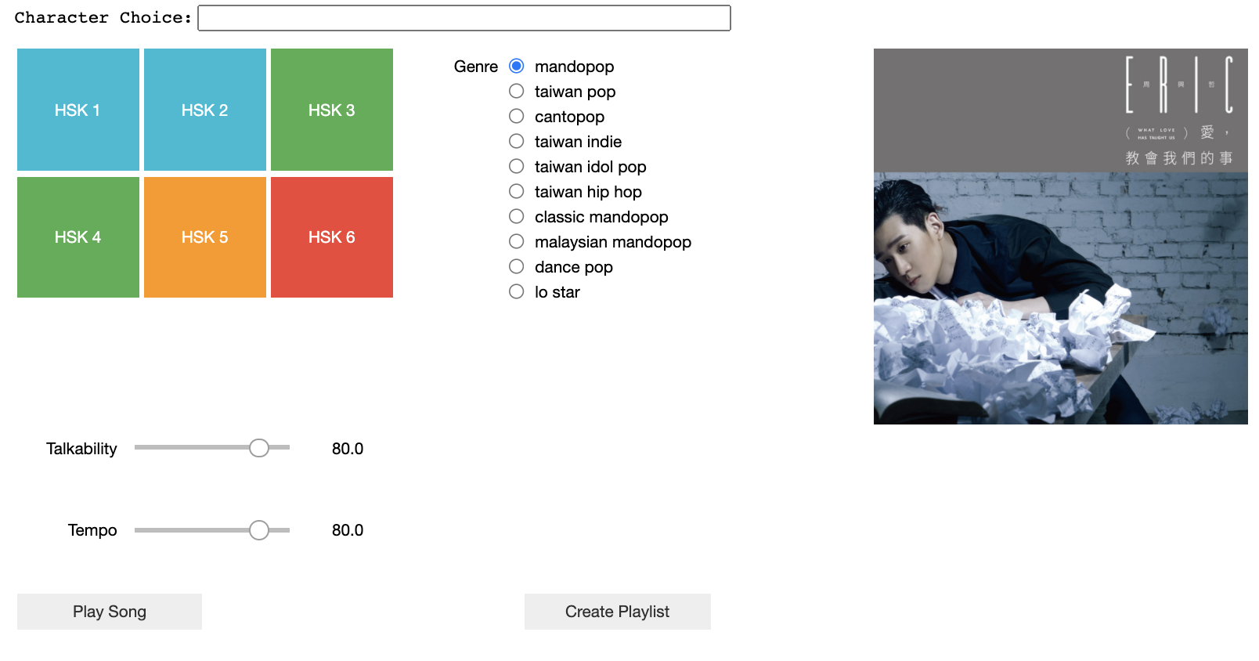
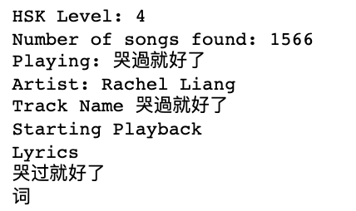
For Fun: Jupyter Notebook Mandarin Spotify Player
Notes:
60 topics
TfidfVectorizer

Slide 23
Thank you for listening

